Slide 1


VideoLAN, VLC and its distribution infrastructure
Ludovic Fauvet - February 22, 2015

Slide 2

Hello!
I am Ludovic Fauvet
VLC developer since 2008
VideoLAN treasurer
Founder of Videolabs SAS
Main developer of Mirrorbits

Slide 3
About this talk...
VideoLAN
Who we are
VLC
The architecture
Mirrorbits
How do we handle distribution

Slide 4
1.
VideoLAN
A non-profit organization made of volunteers

Slide 5
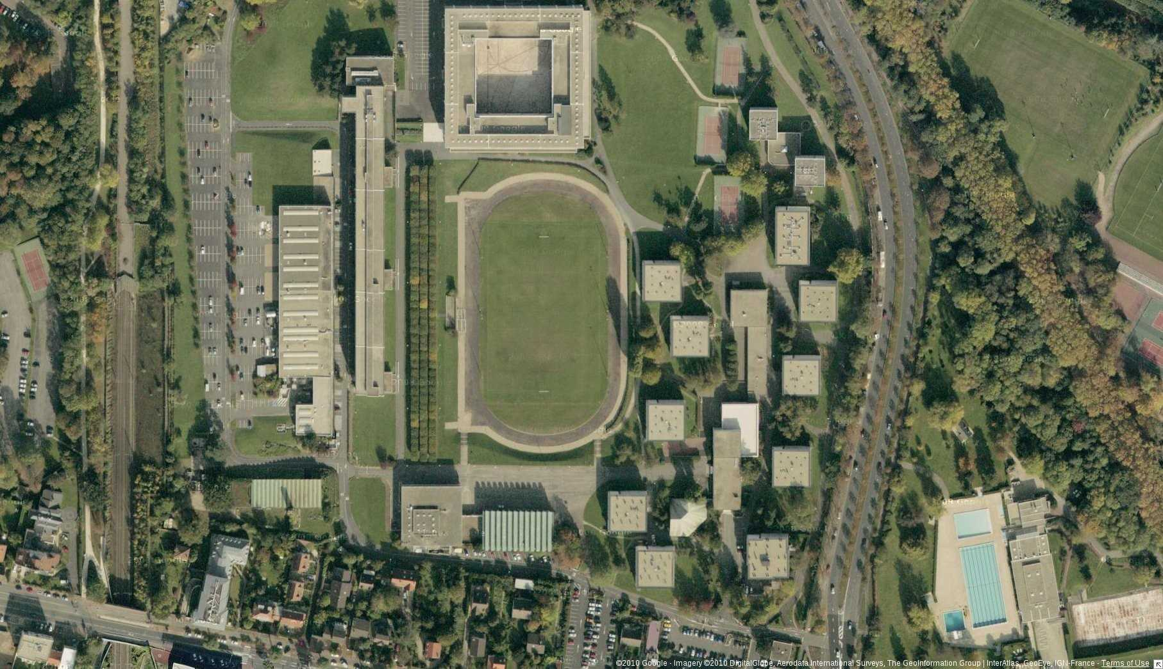
ÉCOLE CENTRALE PARIS
Where it started

Slide 6
VIA Centrale Réseaux
Campus student association
(Slow) Internet access through RENATER
Token Ring
Desperately in need of a new (ethernet) network!

Slide 7
VIA Centrale Réseaux
Problem:
Who's going to pay?
How to justify the need for a faster network?
1995 epiphany!
Let's do video streaming!

Slide 8
Early days
Proof of concept
1995 – 96
Took 2 years to complete...
Project reboot
1998
Open-Source
Modular
Cross-Platform
Network oriented
Student project
License change
2001
ECP headmaster agreement
GPL v2 (or later)

Slide 9
Early days
2001 – 2002
Peer-to-peer
Codecs pandemonium
Playback of uncompleted files
“VLC rule them all!”
– Anonymous

Slide 10
VideoLAN today
French non-profit organization
  Created in 2009
  Libre / Free software and Multimedia
28 members (all volunteers)
  Core developers
  Important members
Survive with donations
  Hardware, servers
  Travel, legal
  VideoLAN Dev'days
~ 15 projects alive

Slide 11

VideoLAN projects
VLC, VLC media player, VideoLAN Client
VLS, VideoLAN server
VLCS
libdvdcss (DVD CSS decryption)
libdts, libdca (DTS decoding)
x264 (H.264 encoding)
libdvbpsi (TS file management)
libdvdplay
libdvbcsa (DVB encryption decoding)
VLMA (VLC automation)
VLC Skin Designer
libbluray, libaacs (BluRay playback)
DVBlast, Multicat (DVB streaming solution)
VLMC (Non-linear video editor)
x262, x265

Slide 12
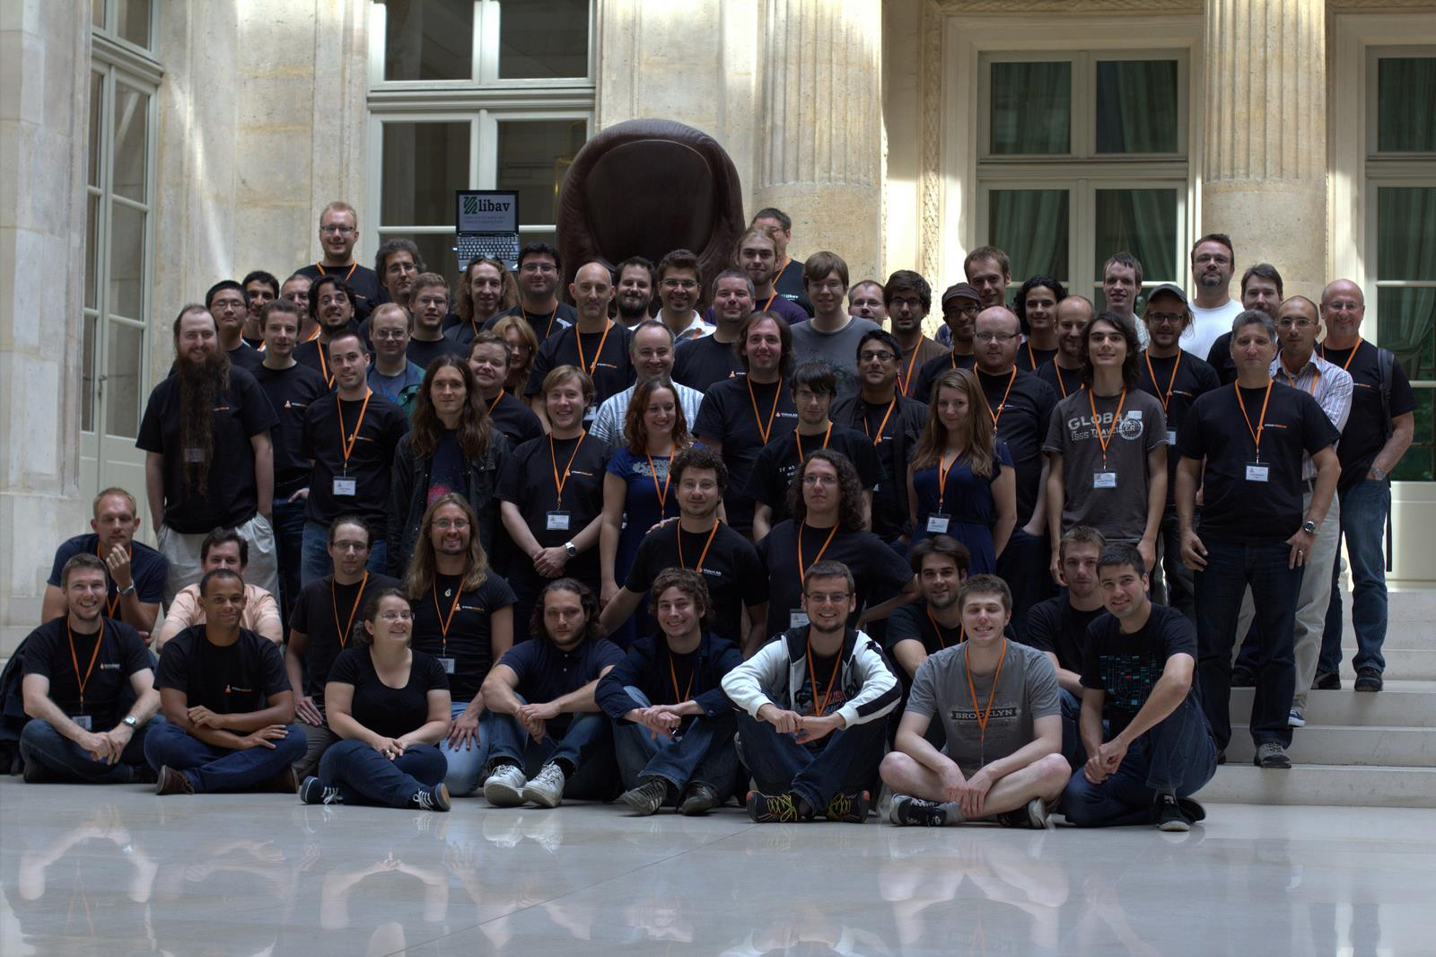
VideoLAN Dev'days 2013
Free HQ, Paris

Slide 13
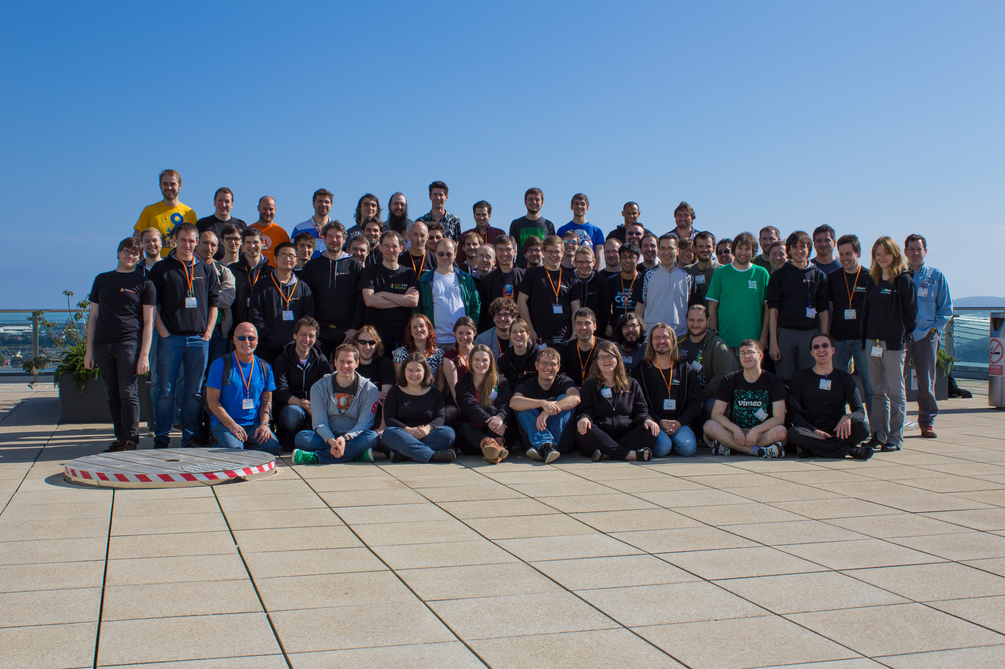
VideoLAN Dev'days 2014
Google, Dublin

Slide 14

Team work
Team meeting at least twice a year
  FOSDEM (Belgium)
  VideoLAN dev'days (Depends)
git since 2007
IRC and mailing lists
Trac, phpBB and mediawiki
Simple rules
Code of conduct ^{New!}

Slide 15
Decisions
VLC contributors
  Core team 5 < 10 people
  150 each year
  600+ in total
Decision-making
  Maintainable!
  Technical and standard compliant
  0 marketing, 0 legal
  Code ➜ Power
  Consensus or Fork (but please don't)

Slide 16
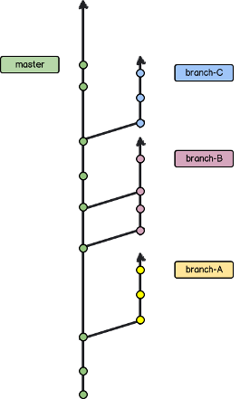
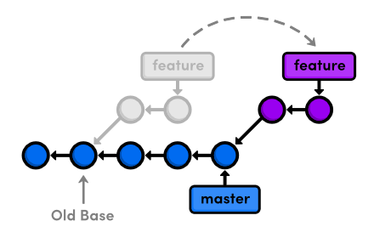
Team work

Slide 17
Welcome in the multimedia wonderland
Sponsored by SARCASM Inc.

Slide 18
Rule #1: In multimedia, if there is a stupid way to do something, someone will do it that way and complain until it is standard and supported.

Slide 19
Rule #2: In multimedia, everyone thinks he understands everything...
… but actually no one does.

Slide 20

NIH syndrome
https://xkcd.com/927/
Licensed under a Creative Commons
Attribution-NonCommercial 2.5 License

Slide 21
NIH syndrom
Containers
Almost all containers are varying between complete crap to somehow broken.
Except MP4 and MKV.
Worst are AVI, FLV and OGG.
Codecs
Many have bad designs
Most have bad encoding
Wrong containers
Too many codecs and profiles

Slide 22

Multimedia in FLOSS
Widely used by some
  Video experts
  Professionnals doing broadcast
Numerous projects, but...
  Abandonned
  Difficult to use
  Usage restricted because of patents

Slide 23

2.
VLC media player
aka “the cone”

Slide 24
VLC media player
Support for DVDs
  Region independent
  Prevents forced subtitles (if desired)
Blurays
  By default, non-encrypted only
Network streams
  Unicast, multicast, adaptive streaming
External hardware
  Cameras, TV input, satellite, ASI/SDI, …
And of course...
plays everything, everywhere!

Slide 25
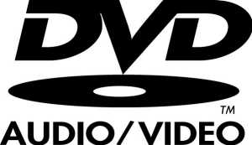







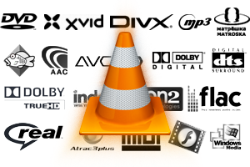


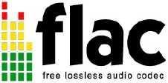






VLC

Slide 26

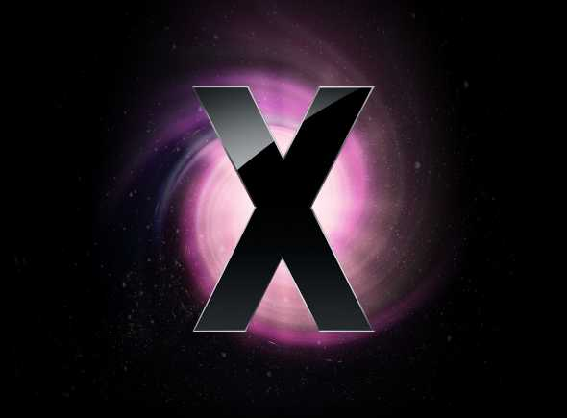

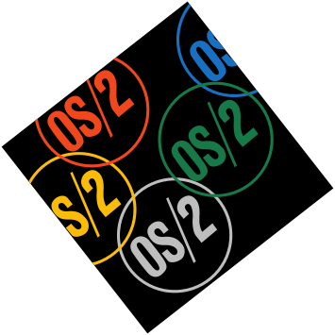





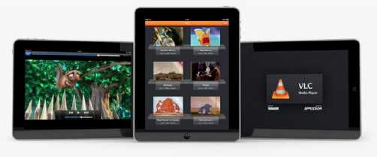

Slide 27
1 million
2+ billion
150 million
downloads per day
downloads since the early days
users on all platforms! *
* Estimated

Slide 28
1/6
Top 15
French
of all Mac
on Windows
most used software

Slide 29
What makes VLC so good?
It's not because of the marketing.
More likely because it just works.

Slide 30
Business logic
Subtitles
Codec
Text Renderer
Access
Demux
Video
Codec
Video Filters
Video Output
Audio
Codec
Audio Filters
Audio Output
Codec
Encoder
Encoder
Muxer
Interfaces
MetaData
Stream

Slide 31
Architecture
libVLCcore
  Small and light
  Memory, Network and Threads handling
  Modules loading
  Clock / Synchronization
libVLC
  Multimedia framework
  Simple C API
  Bindings for C++, C#, Objective-C, Java, lua, Perl, Python and even Node.JS

Slide 32
VLC
VLMC
Applications
libVLC
libVLCcore
Decoder
Theora
Vorbis
x264
Demuxer
Mux
Ogg
MKV
Interface
Vout
Aout
Filters
Modules
Modules
Modules
Modules

Slide 33
libVLC
Full multimedia framework
  Playback
  Filters
  Controls
  Streaming (limited)
  DVD Ripper, Thumbnailer, ...
Used by
  VLC mobile (Android, iOS and Windows Phone)
  Phonon (KDE)
  Many more...

Slide 34
Service discovery
Detects media automatically
  Network services
    UPnP / DLNA
    Samba
  Internet services
    Resolves Youtube, Dailymotion, Vimeo, …
Highly customizable
  Written in Lua
  Publish and get them from addons.videolan.org

Slide 35
What you don't know about VLC
Transcoding, Streaming
TS encryption and decryption (DVB-CSA)
DVD and CD ripper
Headless version
Karaoke, Midi
Hardware decoding
Web interface (used by most remotes)
Scriptable with extensions
but that's not all...

Slide 36
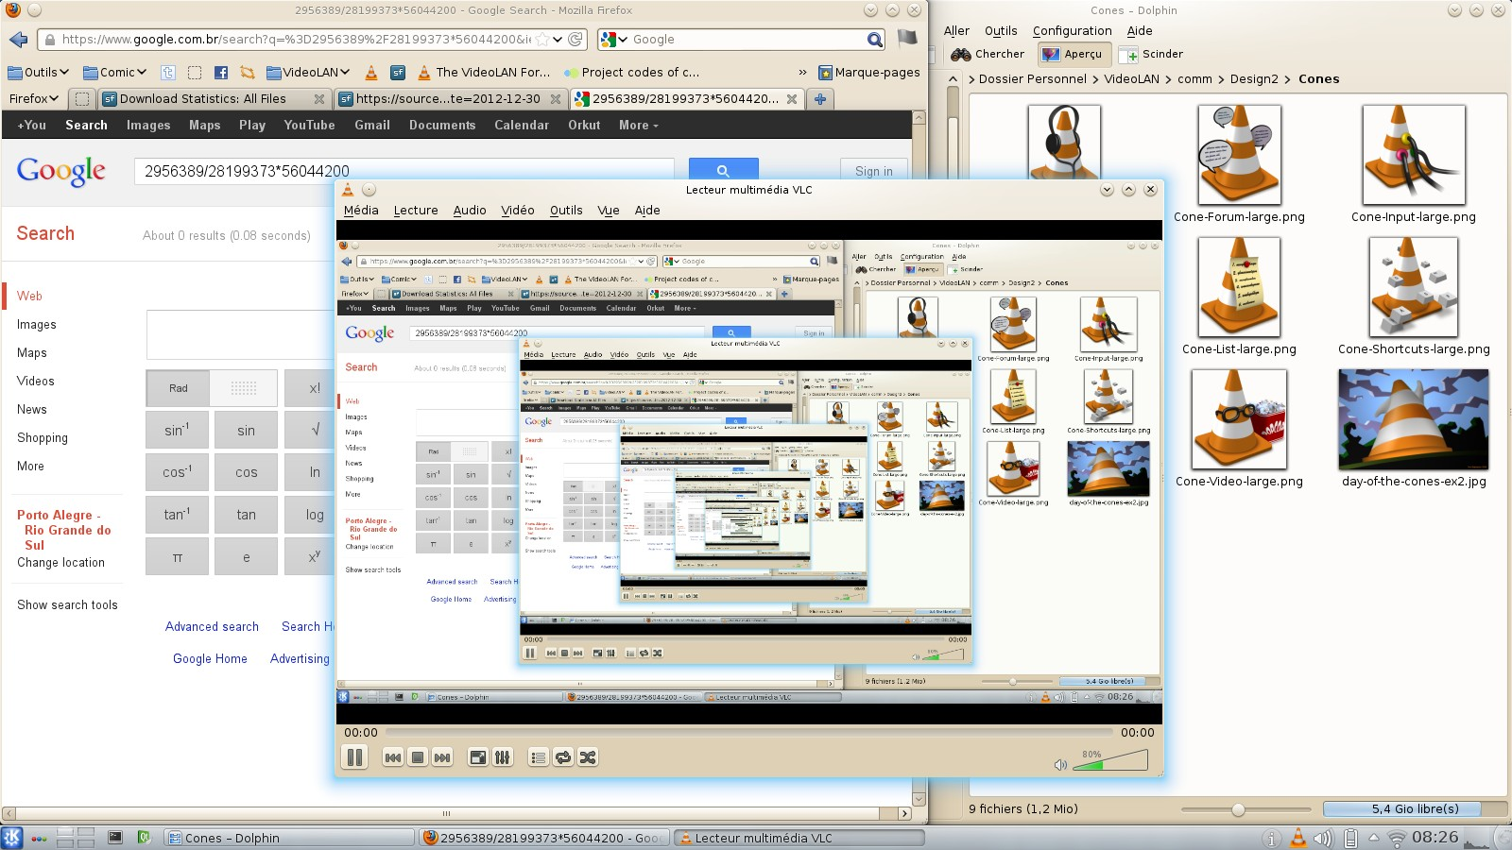
Screencasting

Slide 37
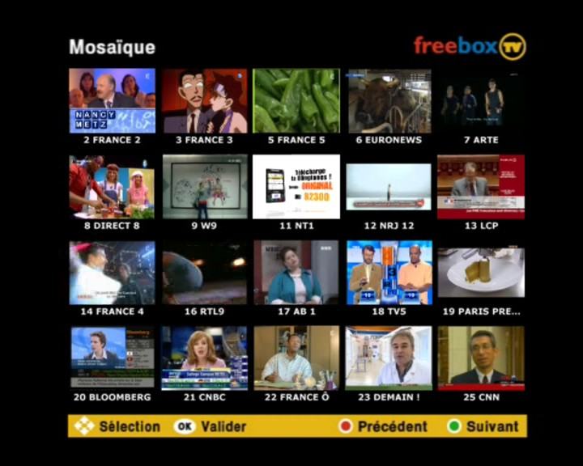
Mosaic

Slide 38
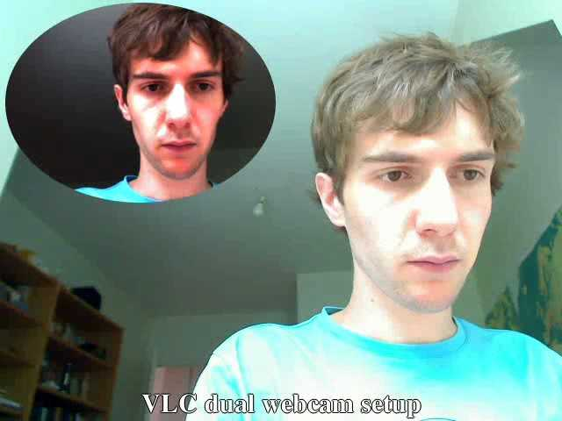
Picture in picture with alpha mask

Slide 39
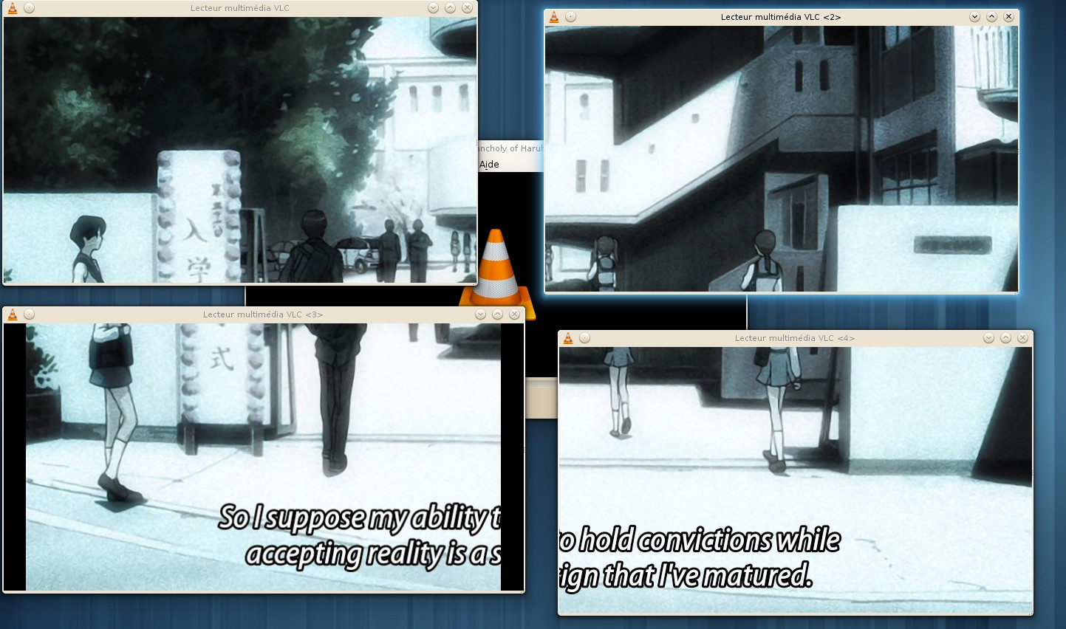
Wall

Slide 40
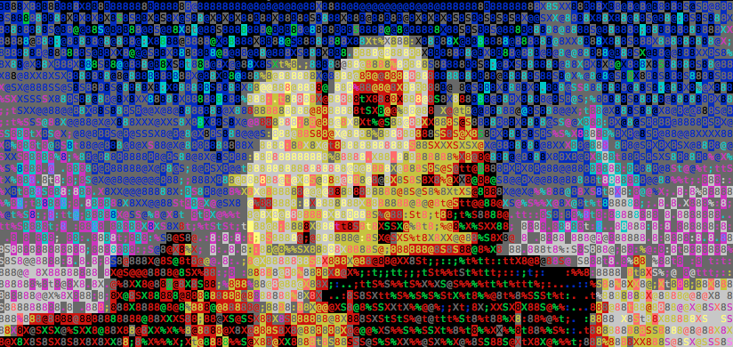
ASCII output with libcaca

Slide 41
What's new in VLC 2.2.0
Better, Faster, Stronger

Slide 42
VLC 2.1.0
Rincewind
Released in October 2013
2.1.1 ➜ 2.1.5
420+ million downloads
Quite stable, but some regressions

Slide 43
VLC 2.2.0
WeatherWax
4475 commits
Took one year and a half to release
Very strong release
Numerous users features

Slide 44

VLC 2.2.0
Video rotation (hi Linus!)
  Detection in MP4, MKV and H264
  Auto-rotation
    Video output request
    GPU accelerated rotation
      Direct3D, OpenGL, Android native (3.0)
    Software rotation

Slide 45
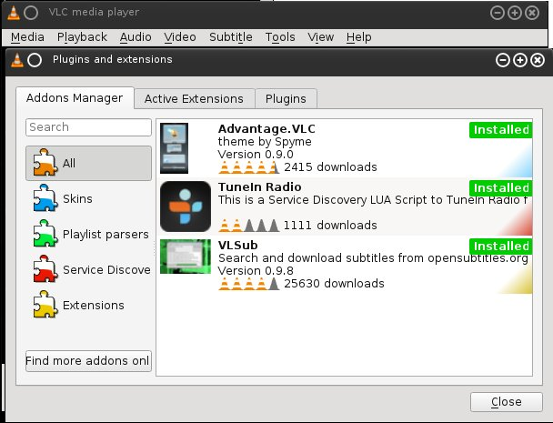
VLC 2.2.0
Extensions manager

Slide 46
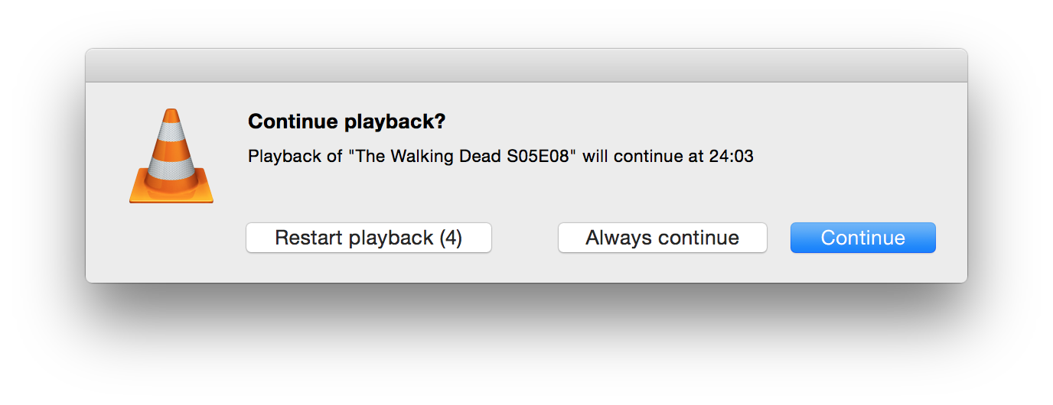
VLC 2.2.0
Resuming

Slide 47
VLC 2.2.0
HEVC, VP9, Opus
  in MKV, TS, MP4
BD-J
FTPS
DCP
Weird codecs
  MSN Audio, Atrac3+, VP7, Bink, TAK, On2 AVC, DK3, DK4, IMC, Vivo g723.1, Smacker, FIC, Auravision, Canopus Lossless...
Speex, FFv1, VP8/Ogg, WebVTT

Slide 48
VLC 2.2.0 – GPU 0-copy
Old way
  memcpy is baaaad
  CPU → GPU → CPU → GPU
New way
  Fake fmt
  Decoding and displaying done on the GPU
Support
  Linux VDPAU
  Android Mediacodec
  Raspberry Pi – MMAL

Slide 49
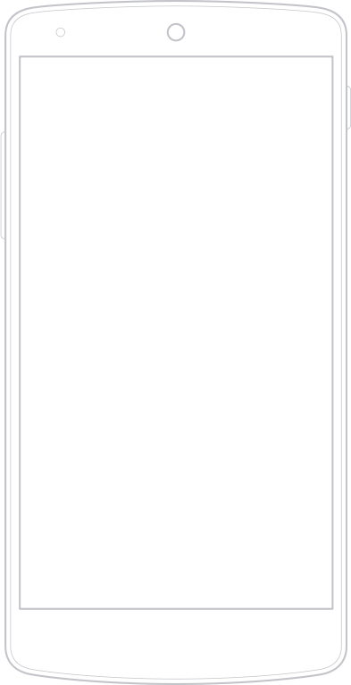
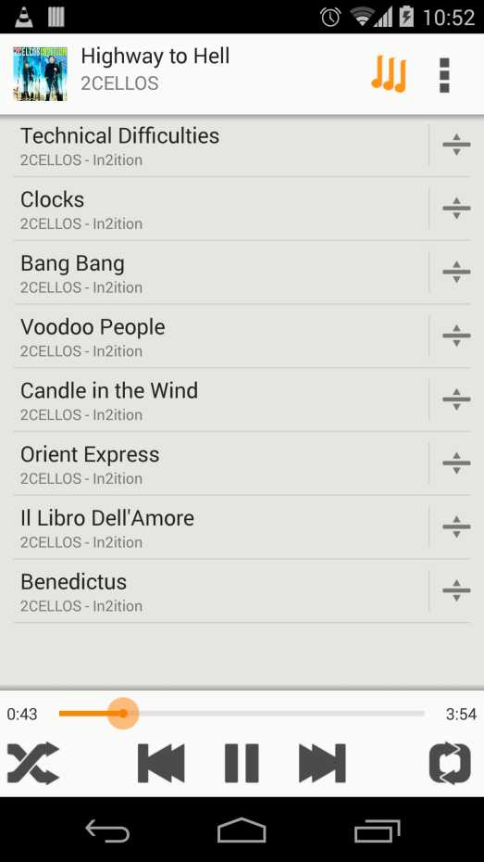
VLC 2.2.0 – Mobile
iOS 2.3.0/2.4.0
  libVLC 2.2.0
Android 1.0.0
  libVLC 2.2.0
WinRT x86 0.1.5
  libVLC 2.2.0

Slide 50
VLC 2.2.0 → 3.0.0
2.2.0 release this week
3.0.0
  HDS, Dash, Smooth streaming
  Wayland
  GPU zero-copy OMX IL
  ARIB subtitles
  HEVC VP9 hardware decoding Android
  Large rework of MP4 and TS demuxers
  SMB and SD browsing

Slide 51
3.
Mirrorbits
The geographic download redirector

Slide 52
The VLC distribution dilemma
Cheap
Reliable
Scalable
  1M+ download / day
  > 4M after new release
Geographically close
  Low latency
  (Supposedly) faster downloads
Bonus: statistics!

Slide 53
Mirrors
Used by many FLOSS projects
rsync + HTTP and/or FTP
User's job to select the right mirror
Pros
  Cheap
  Simple
Cons
  Not reliable
  Not scalable

Slide 54
Mirrorbits
Same mirror architecture
  rsync + http and/or FTP
Geographic load-balancer
  HTTP 302 Redirect
Smart
  Knows which files are served by a mirror
  Monitors their state (up / down)
  Avoids hot spots
  Checksum when possible
Provides download stats in realtime

Slide 55
How it works
Mirrorbits
Mirror #1
Mirror #2
Mirror #3
Mirror #3
Mirror #4

Slide 56
Mirrorbits
Written in Go
Easy to deploy
Very fast!
  8K req/s on my laptop
Redis backend
Open-Source (MIT)
http://github.com/etix/mirrorbits

Slide 57
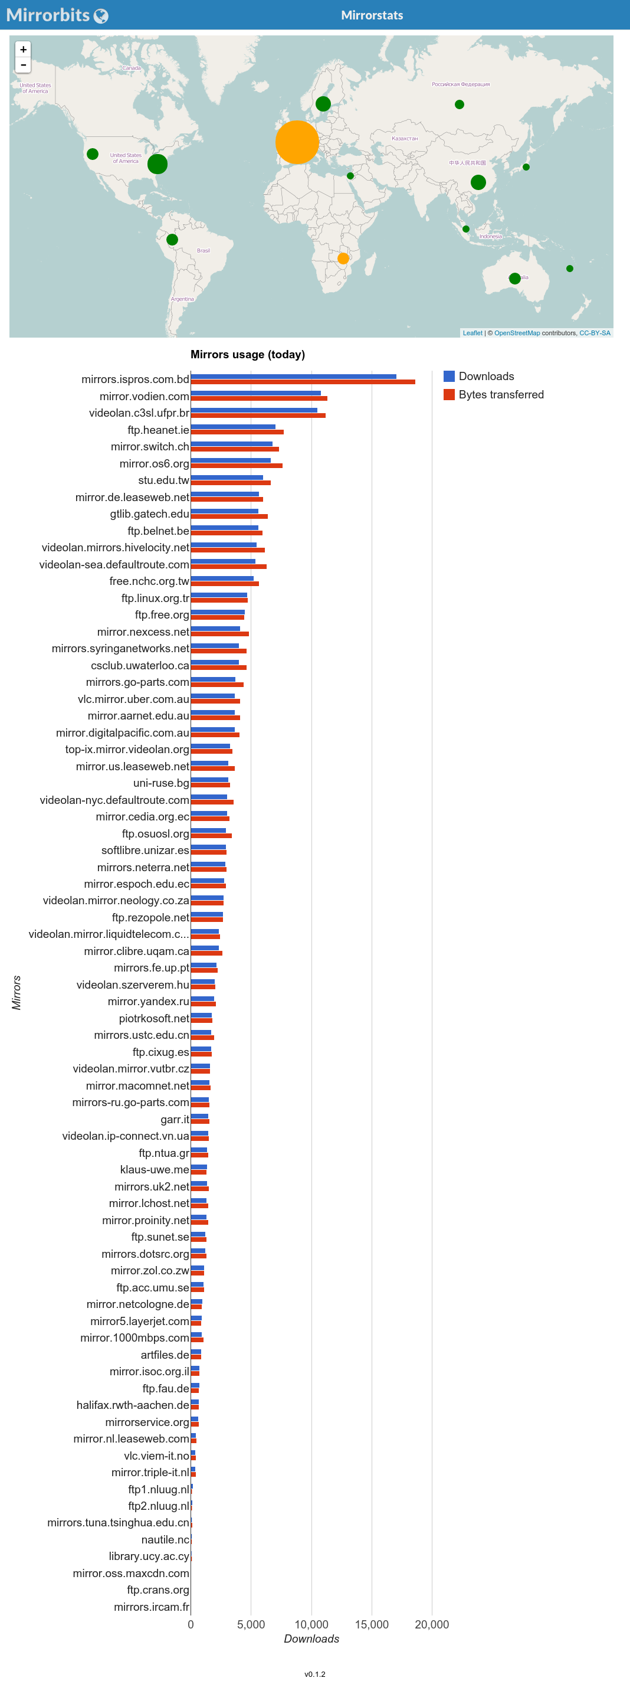
Mirrorstats

Slide 58
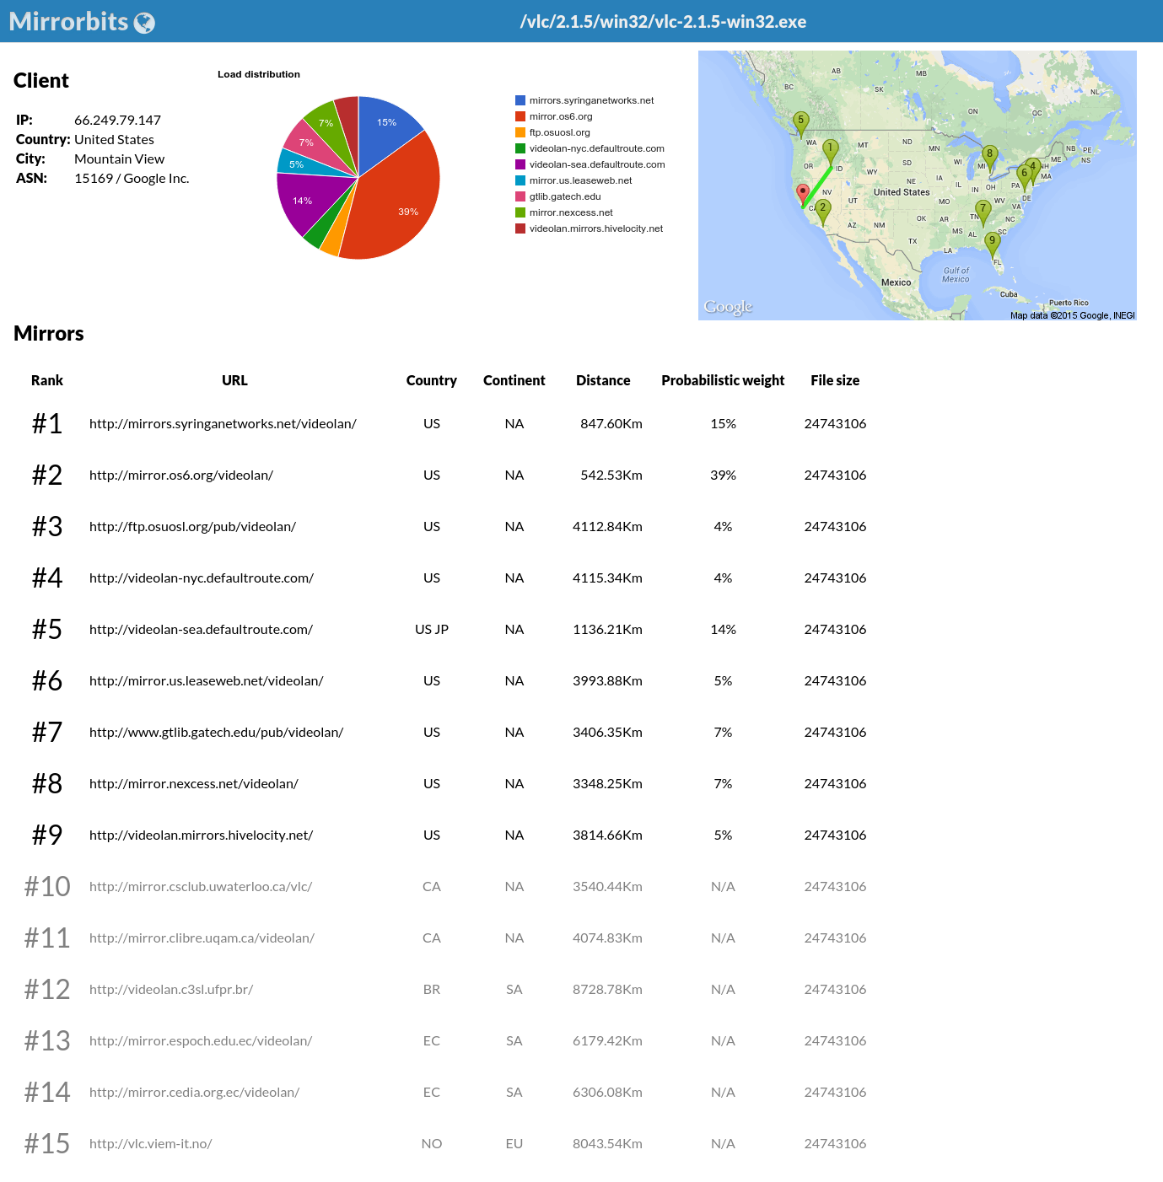
Mirrorlist

Slide 59
Mirrorbits in production
VideoLAN
  Since May 2014
SuperRepo (XBMC / Kodi addons repository)
  Since July 2014
Popcorn Time
  November 2014
You?

Slide 60
250,000,000
downloads handled by Mirrorbits
Milestone reached yesterday!

Slide 61
Thanks!
Any questions?
Twitter: @etixxx
etix@videolan.org

